Slide 1


Slide 2

Lets Explore

Slide 3

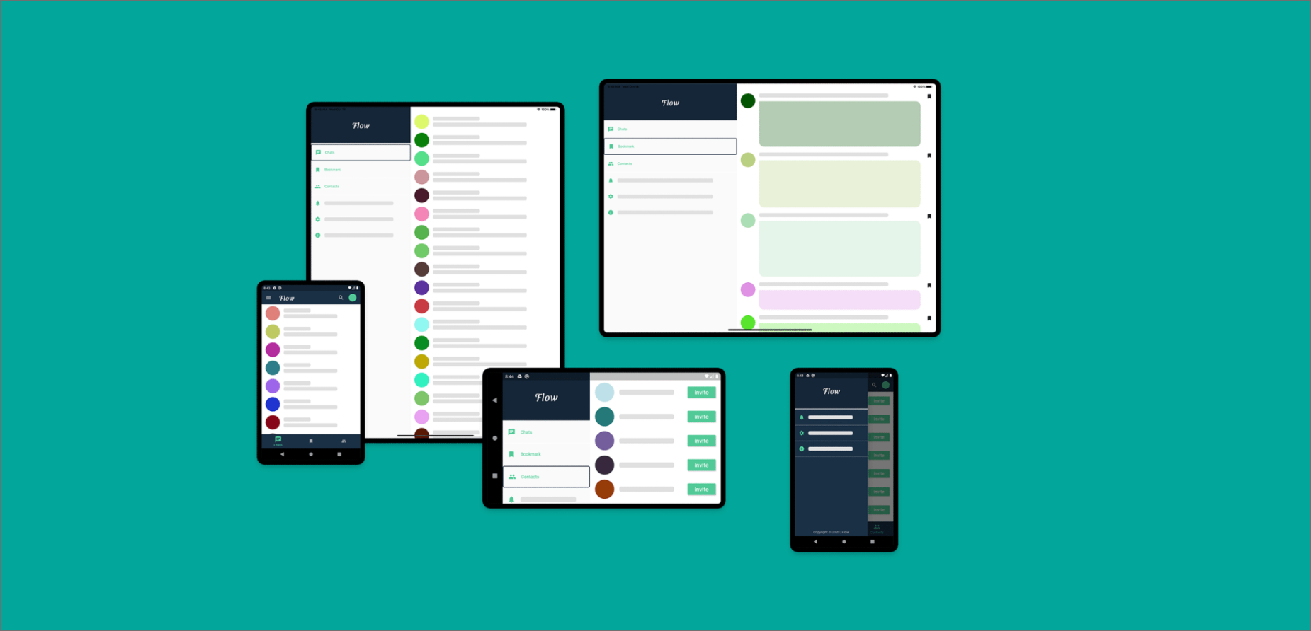
Lets Explore

Slide 4
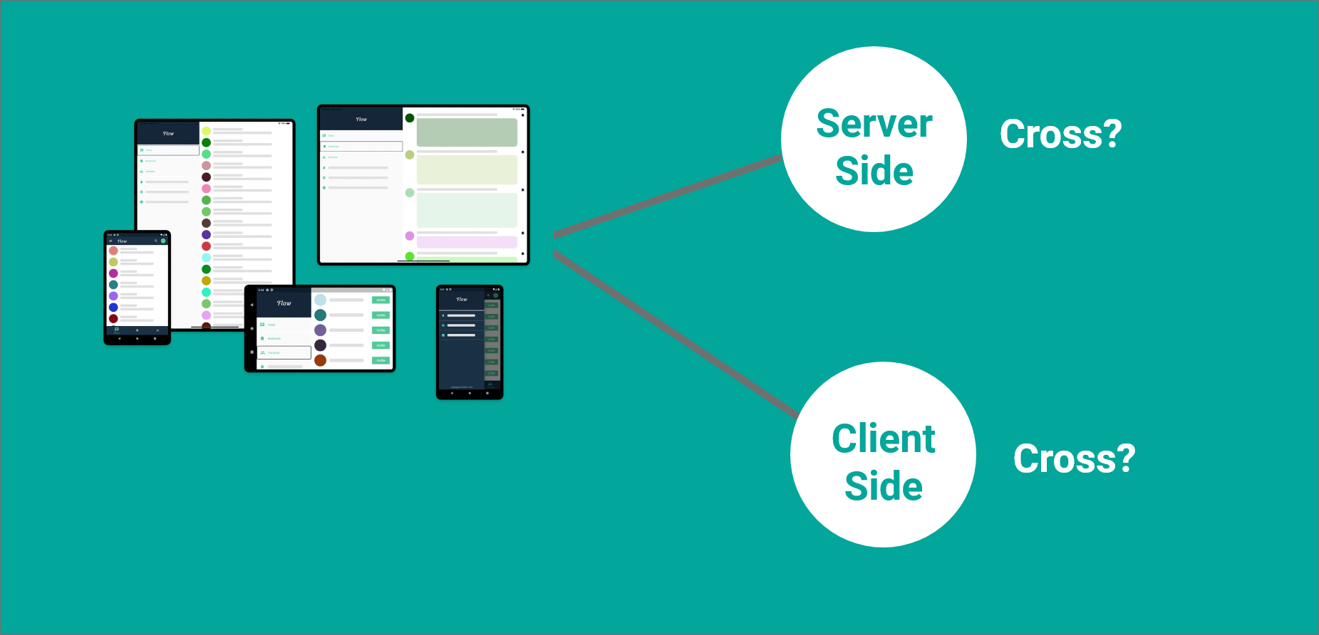
Lets Explore

Slide 5

Don't be misguided

Slide 6

Only one is enough & enough

Slide 7


Our destination

Slide 8




Course Focused For

Slide 9



Course Designed For

Slide 10
STEP 01
Learn Dart Programming First
# ফাংশন :Parameters,Returns, Callback, Anonymous functions, Arrow Function, Async/await
......................
# লুপঃ For Loop, For in loop, For Of Loop, Conditional Loop, Nested Loop
......................
# অ্যারেঃ Simple Arrays, Multidimensional Arrays, Array de-structuring, Map, Set.
......................
# জেসনঃ JSON Object, Array,JSON parse
......................
# ওওপিঃ Class, Object, Constructor, Inheritance, Static, final
......................
# এক্সেপশন হ্যান্ডেলিংঃ Try Catch

Slide 11
STEP 02
Flutter Basics
Introduction to the open source SDK by Google
Flutter – Architecture Application
Android Studio Setup for Flutter Development
Getting Started with Cross-Platform Mobile Application using Flutter

Slide 12
STEP 03
Key Widgets
Container class in Flutter
Scaffold class in Flutter with Examples
MaterialApp class in Flutter
Drawer Widget in Flutter
Flutter – AppBar Widget
Flutter – RichText Widget

Slide 13
STEP 04
UI Components
Flutter – Tabs
Flutter – Horizontal List
Flutter – Expansion Tile Card
Icon Class in Flutter
Expanded Class in Flutter
Flutter – Dialogs
Flutter – Circular & Linear Progress Indicators
Flutter – Staggered Grid View

Slide 14
STEP 05
Design & Animations
Customizing Fonts in Flutter
Flutter – Skeleton Text
Flutter – Themes
Flutter – Lazy Loader
Flutter – UI Orientation
Flutter – Animation in Route Transition
Flutter – Physics Simulation in Animation
Flutter – Radial Hero Animation
Flutter – Hinge Animation
Flutter – Lottie Animation

Slide 15
STEP 06
Forms & Gestures
Form Validation in Flutter
Designing a Form Submission Page in Flutter
Flutter – Gestures

Slide 16
STEP 07
Navigation & Routing
Routes and Navigator in Flutter
Flutter – Named Routes
Flutter – Arguments in Named Routes
Multi Page Applications in Flutter
Flutter – Send Data to Screen

Slide 17
STEP 08
Hardware Interaction
Gallery Access in Flutter
Camera Access in Flutter
Background local notifications in Flutter
Restrict Landscape mode in Flutter

Slide 18
STEP 9
Firebase
Push notification
Real-time create, read, update, delete

Slide 19
STEP 10
Simple Practice Project’s
Blog list app
To-do App
Weather App
Expense manager App

Slide 20
STEP 11
Portfolio Project’s
Inventory app
Ecommerce app

Slide 21

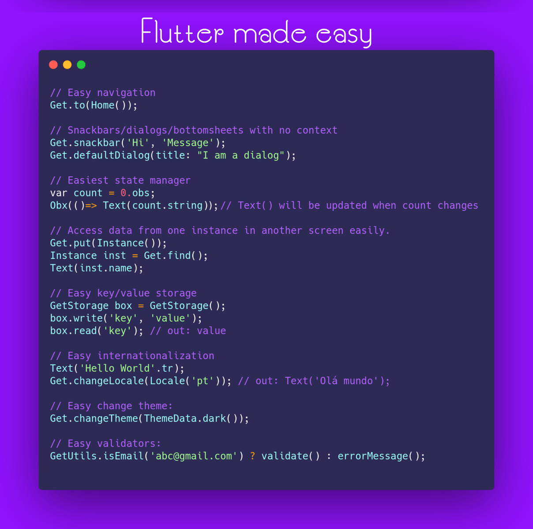
Essential Libraries
Getx

Slide 22
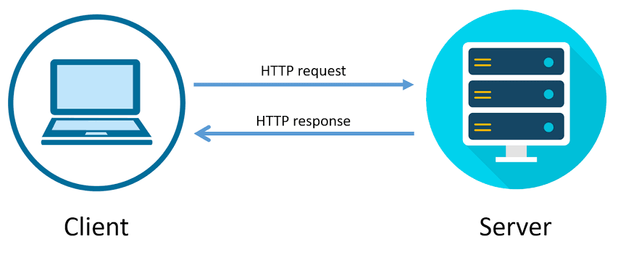
Essential Libraries
HTTP

Slide 23
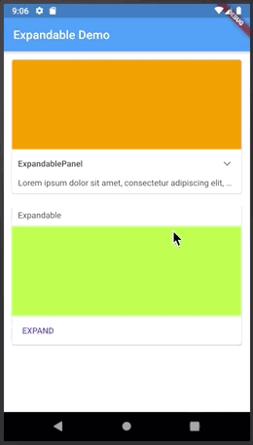
Essential Libraries
Expandable

Slide 24
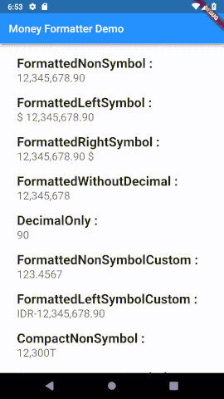
Essential Libraries
Money
Formatter

Slide 25
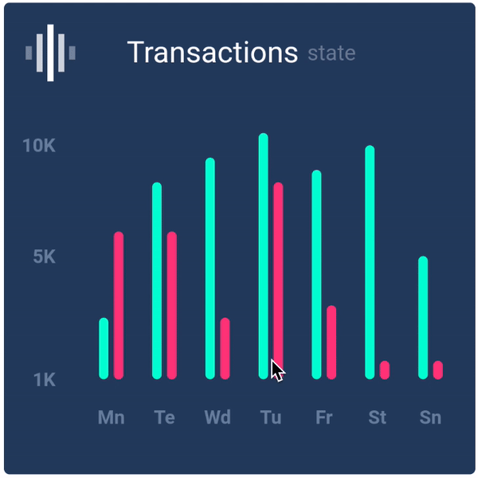
Essential Libraries
Flutter
Chart

Slide 26
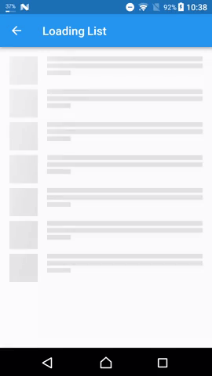
Essential Libraries
Flutter
Shimmer

Slide 27
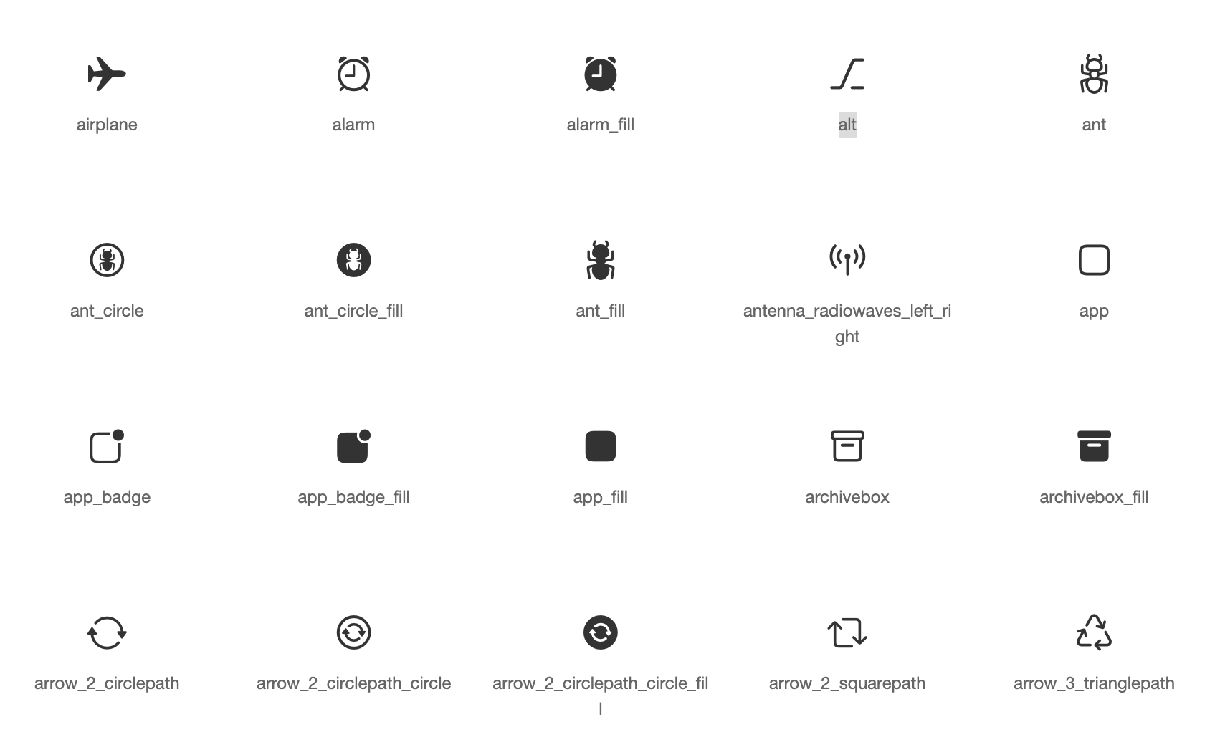
Essential Libraries
Flutter
Fontawesome

Slide 28
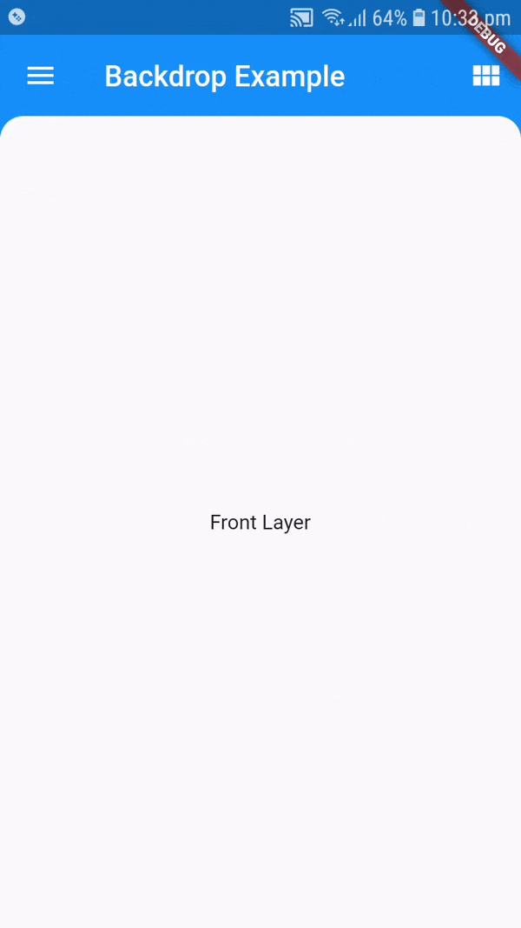
Essential Libraries
Backdrop

Slide 29
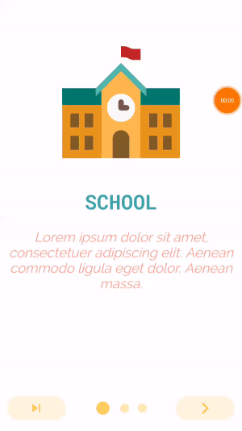
Essential Libraries
Intro Slider

Slide 30
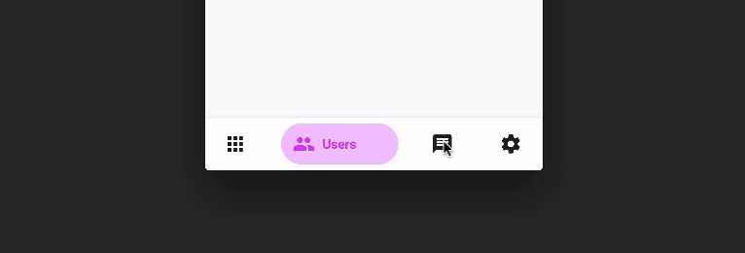
Essential Libraries
Bottom
Navy
Bar

Slide 31

Essential Libraries
Local
Auth

Slide 32
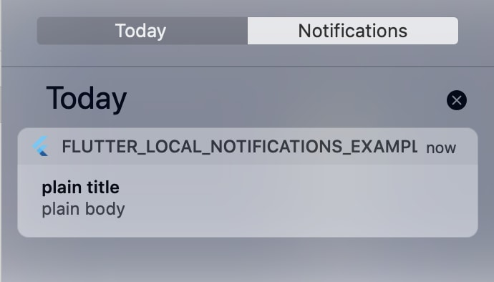
Essential Libraries
Local
Notifications

Slide 33
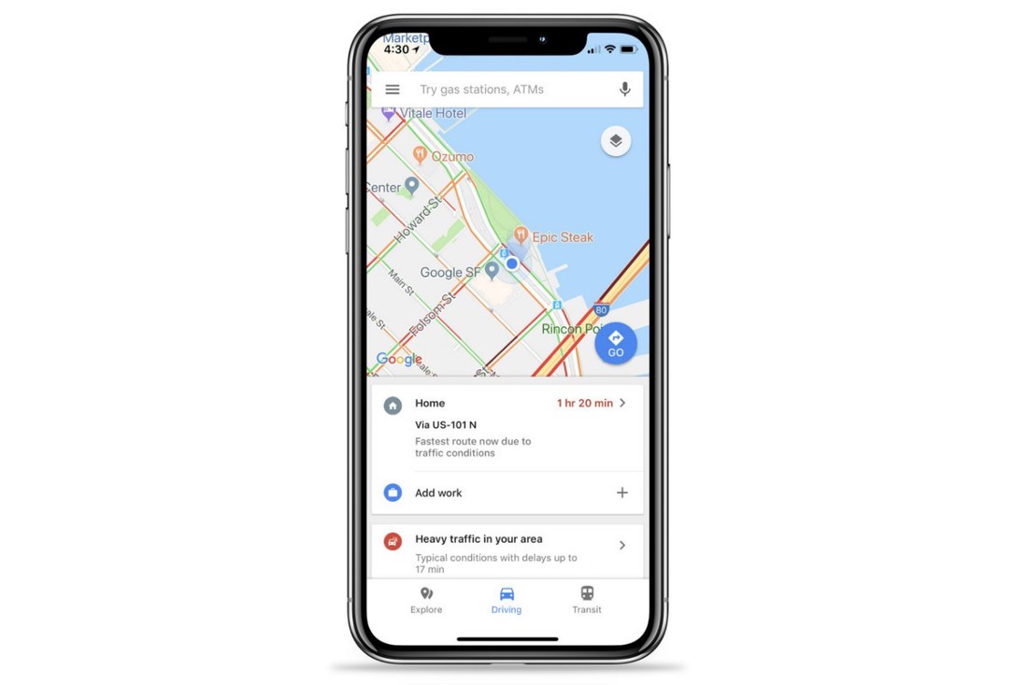
Essential Libraries
Google
Maps
flutter

Slide 34
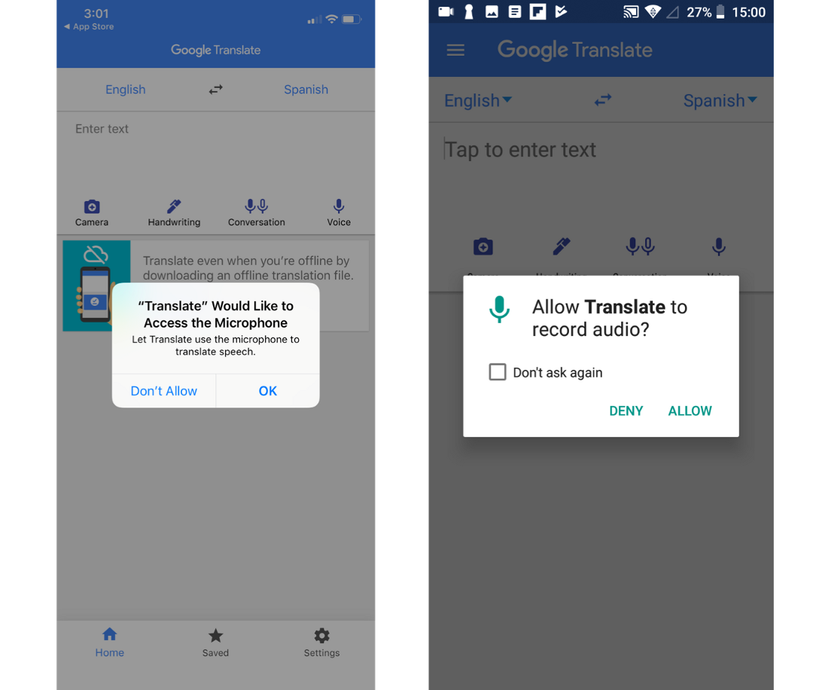
Essential Libraries
Permission
handler

Slide 35
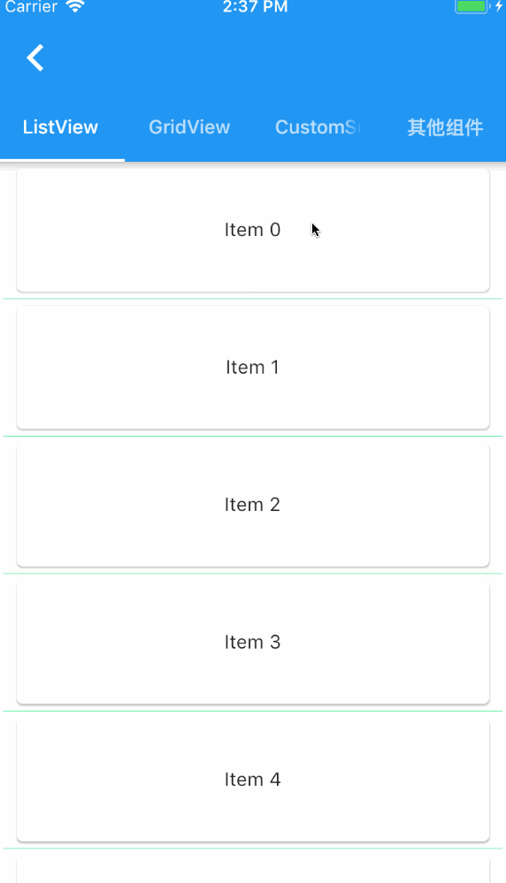
Essential Libraries
Pull
refresh

Slide 36
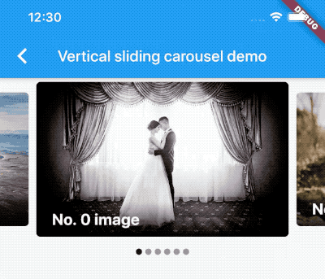
Essential Libraries
Carousel
Slider

Slide 37

Essential Libraries
Flutter
Tensorflow

